Slide 1

Online Retail Sales Analysis & RFM Segmentation
End-to-end analysis of Online Retail II to understand revenue distribution, customer behavior, and actionable strategies using Python, SQL, and Power BI.

Slide 2

Executive Summary
Revenue Concentration
Churn Risk
Champions (896 customers) generate 64.4% of total revenue — revenue is highly skewed toward repeat buyers.
1021 customers are classified as Lost Customers; retention is more important than acquisition.
Tools & Platforms
Analysis implemented with Python (Pandas, NumPy), MS SQL Server, and Power BI for visualization.

Slide 3

Business Problem
Key Challenges
High customer churn; revenue concentration risk; inefficient marketing spend; lack of behavioral segmentation.
Project Goals
Understand revenue patterns, identify high-value customers, segment via RFM, and provide strategic recommendations.

Slide 4
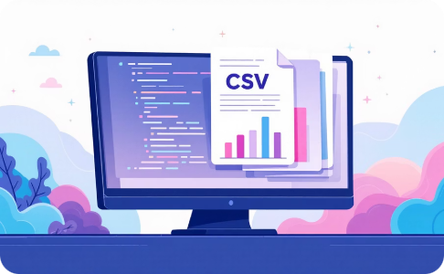
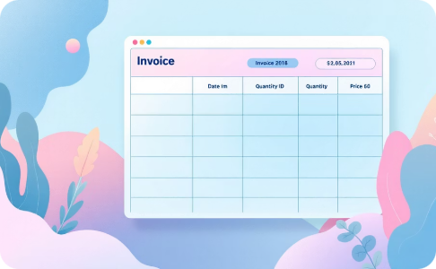
Dataset Overview
Source
Key Columns
UCI Machine Learning Repository — Online Retail II (transactional, multi-year, includes returns/cancellations, country-level sales).
Invoice (ID), Quantity, Price, InvoiceDate, CustomerID, Country — used to compute Revenue = Quantity × Price and YearMonth.

Slide 5

Data Quality & Cleaning
Issues Identified
Cleaning Decisions
Missing CustomerID, negative Quantity (returns), duplicate records, incorrect data types.
Remove negative quantities (returns), deduplicate, correct types, compute Revenue and YearMonth features.

Slide 6

SQL-Based RFM Modeling
RFM computed in MS SQL Server for scalable aggregation: Recency (days since last purchase), Frequency (distinct invoices), Monetary (sum of TotalPrice). Scores assigned via quantiles (1–5) and combined as R+F+M.

Slide 7



Segmentation & Results
Champions
Lost Customers
Potential Loyalists
896 customers → 64.4% of revenue. Core revenue drivers; retention is critical.
1021 customers; 400K revenue. Indicates churn and business risk.
1114 customers; 712K revenue. Opportunity to convert via targeted campaigns.

Slide 8
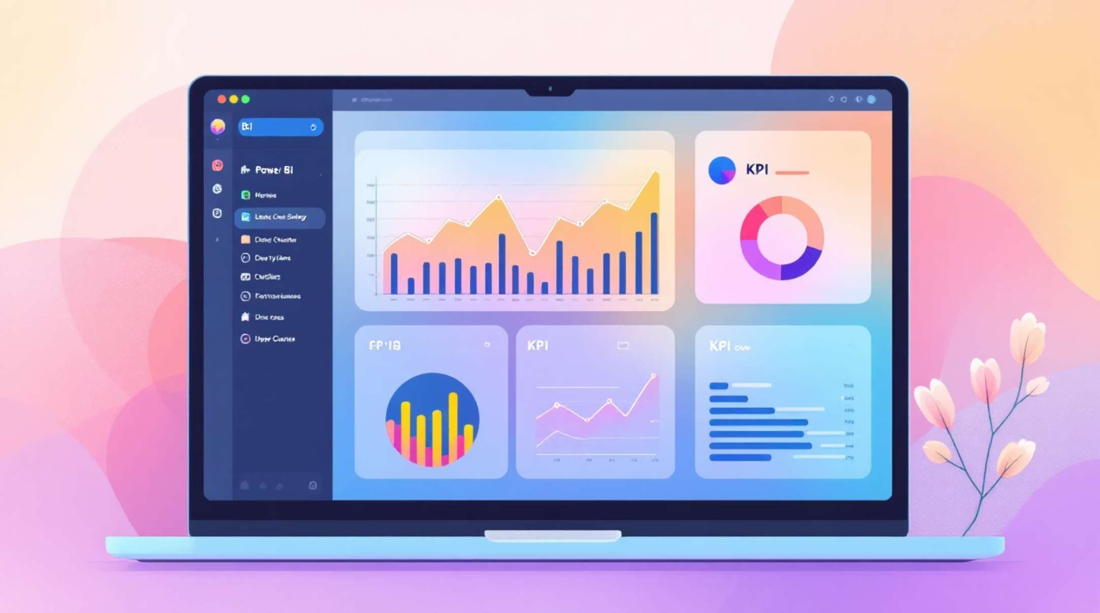
Power BI Dashboard & KPIs
Dashboard Pages
1) Executive Overview 2) Product Intelligence 3) Customer Intelligence
KPIs & Visuals
Last Month Revenue, Customer Count, Total Orders, AOV; Revenue trend (line), revenue by country (bar), top products, segment distribution, Final_RFM table.
DAX Measures
SUM(), CALCULATE(), DISTINCTCOUNT(), RANKX(), DIVIDE() for dynamic metrics and segmentation.

Slide 9

Statistical Observations & Business Implications
Observations
Revenue distribution is right-skewed; frequency follows a power-law; high variance in monetary spending — dependency on a small customer cluster.
Implications
If Champions churn, revenue impact is large. Converting Potential Loyalists can increase revenue without acquisition cost.

Slide 10


Recommendations, Limitations & Future Scope
Strategic Actions
Limitations & Future Work
Champion retention (loyalty, exclusive offers); Lost customer re-engagement (email, discounts); convert Potential Loyalists (personalized recommendations); reduce concentration risk (mid-tier engagement).
No marketing campaign, profit margin, or demographics data. Future scope: predictive churn models, CLV, ML segmentation, and time-series revenue forecasting.

